Slide 1
Indexing
Chapter 21

Slide 2
Objects
Three common ways to implement an index
Static Hashing
Extendable Hashing
B-trees
Implementations of the relational algebra operations
Select
Join

Slide 3
Contents
The Index Interface
Static Hash Indexes
Extendable Hash Indexes
B-Tree Indexes
Index-Aware Operator Implementations
Index Update Planning

Slide 4
Contents
The Index Interface
Static Hash Indexes
Extendable Hash Indexes
B-Tree Indexes
Index-Aware Operator Implementations
Index Update Planning

Slide 5
The Index Interface
An Index is a file that is organized on some fields of a table.
Each index record
corresponds to a data record
contains 2 values: a value for the indexed fields, the record identifier(rid)
When the database system wants to find the data records
go to the index
find the specified index records
use the rids stored in those index records

Slide 6
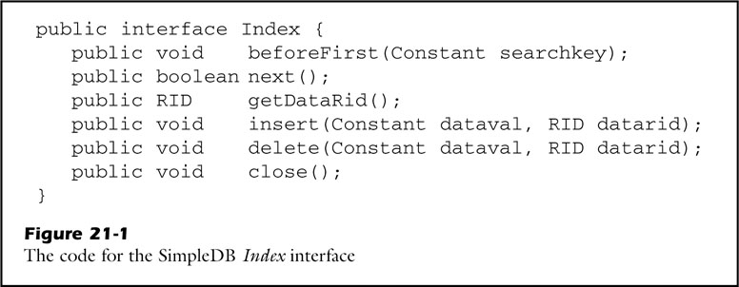
The Index Interface
In SimpleDB, an index can have only one indexed field.
An index record consists of two values; dataval, datarid
Each SimpleDB index record contains a dataval and a datarid.
The dataval is the value of the indexed field.
The datarid is the rid of the corresponding data record.
An index in SimpleDB is an object in a class that implements the interface Index.
Takes search key as its argument

Slide 7
The Index Interface
In SimpleDB, an index can have only one indexed field.
An index record consists of two values; dataval, datarid
Each SimpleDB index record contains a dataval and a datarid.
The dataval is the value of the indexed field.
The datarid is the rid of the corresponding data record.
An index in SimpleDB is an object in a class that implements the interface Index.
Moves the index
to the next record

Slide 8
The Index Interface
In SimpleDB, an index can have only one indexed field.
An index record consists of two values; dataval, datarid
Each SimpleDB index record contains a dataval and a datarid.
The dataval is the value of the indexed field.
The datarid is the rid of the corresponding data record.
An index in SimpleDB is an object in a class that implements the interface Index.
Returns the datarid
of the current index record

Slide 9
The Index Interface
A SimpleDB client searches an index:
By providing a value (called the search key)
By retrieving the index records having a matching dataval
An index does not need general-purpose getInt and getString method.
All index records have the same 2 fields.
It needs to the only retrieval method ‘getDataRid’.

Slide 10
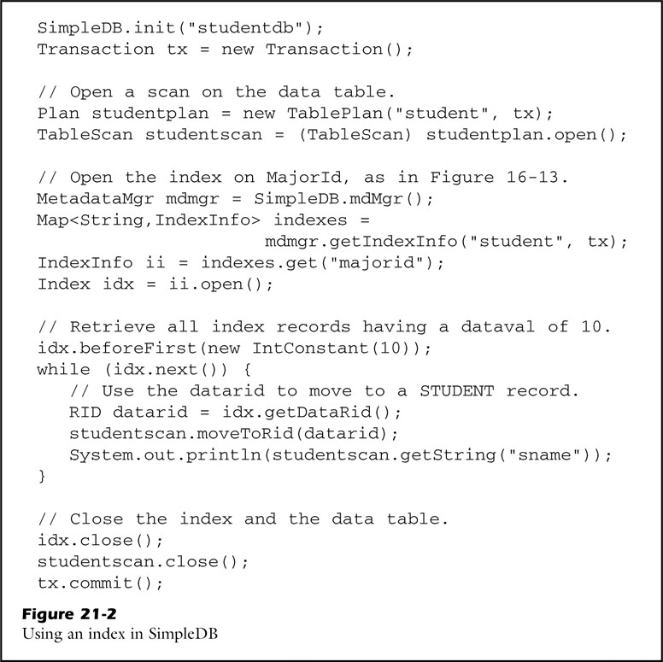
The Index Interface
To retrieve the STUDENT records

Slide 11
The Index Interface
Open the index on ‘MajorId’

Slide 12
The Index Interface
Position the scan at the desired record

Slide 13
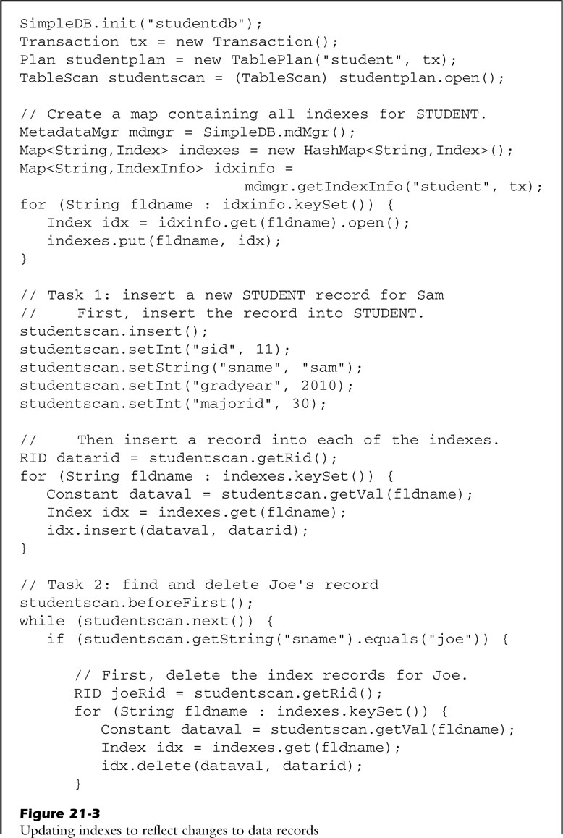
The Index Interface
Insert a new record into STUDENT
Insert a corresponding record
in each index for STUDENT

Slide 14
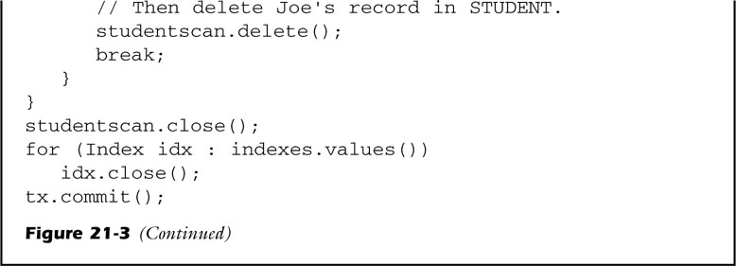
The Index Interface
Delete the index records having ‘Joe’
Delete the records for ‘Joe’ in STUDENT

Slide 15
Contents
The Index Interface
Static Hash Indexes
Static Hashing, Implementing Static Hashing
Extendable Hash Indexes
B-Tree Indexes
Index-Aware Operator Implementations
Index Update Planning

Slide 16
Static Hashing
A static hash index stores index records in buckets.
Use a fixed number N of buckets
Records having the same hash value are stored in the same bucket.
Use a hash function, which maps values to buckets
The intent of hash index is to distribute the records equally among the buckets.
A static hash index works as follows:
Put it into the bucket obtained by hashing the search key (to store an index record)
Hash the search key and examine that bucket (to find an index record)
Find it, and delete it from the bucket (to delete an index record)

Slide 17
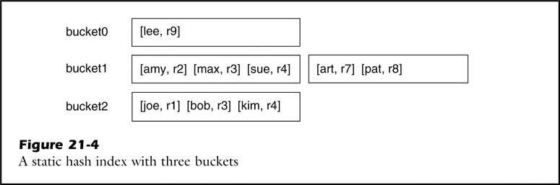
Static Hashing
The search cost of a hash index is related to how many buckets it has.
Ex) B blocks, N buckets Each bucket has B/N blocks long, and B/N block accesses.
For example, consider that an index has N=3 and 3 index records fit into a block.

Slide 18
Static Hashing
Find the datarid of all students named “sue”
Hash the string “sue” to get bucket 1
Require 2 block accesses

Slide 19
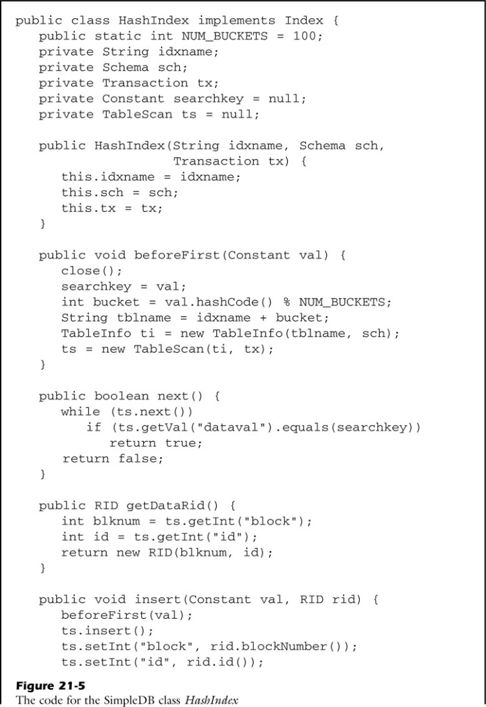
Implementing Static Hashing
Name of a separate table is the catenation of the index name and the bucket number.
ex) the table for bucket #35 of index SID_INDEX is named “SID_INDEX35“.

Slide 20
Implementing Static Hashing
Hashes the search key
Opens a table scan for the resulting bucket

Slide 21
Implementing Static Hashing
Starts from the current position in the scan
Reads records until one is found having the search key

Slide 22
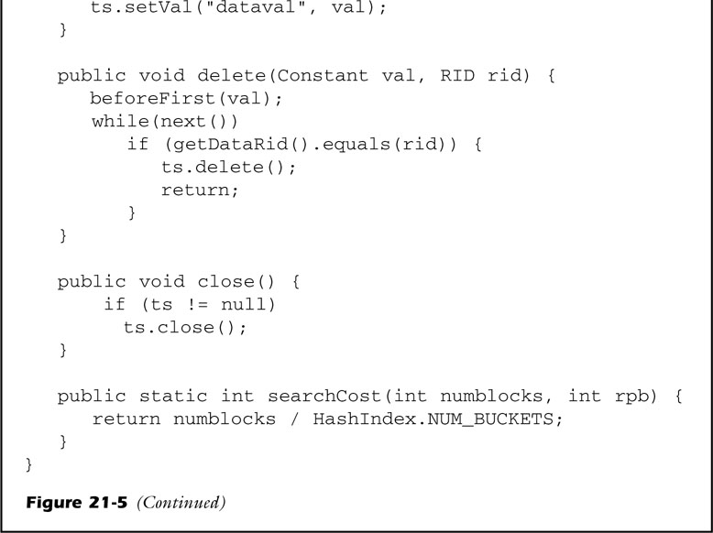
Implementing Static Hashing
Computes the search cost that depends only on the index size
Number of blocks / Number of bucket

Slide 23
Contents
The Index Interface
Static Hash Indexes
Extendable Hash Indexes
Sharing Index Blocks, Compacting the Bucket Directory
B-Tree Indexes
Index-Aware Operator Implementations
Index Update Planning

Slide 24
Extendable Hash Indexes
Hash indexes can have 2 types of bucket size.
The buckets based on the current index size
A larger number of buckets based on future needs
Extendable hashing solves above problem.
By using a very large number of buckets
→ guaranteeing that each bucket will never be more than 1 block long
By allowing multiple buckets to share the same block
This idea uses very little wasted space.
The sharing of block by buckets is achieved by means of two files: → The bucket file and the bucket directory
The bucket file contains the blocks of index records.
The bucket directory maps buckets to blocks.

Slide 25
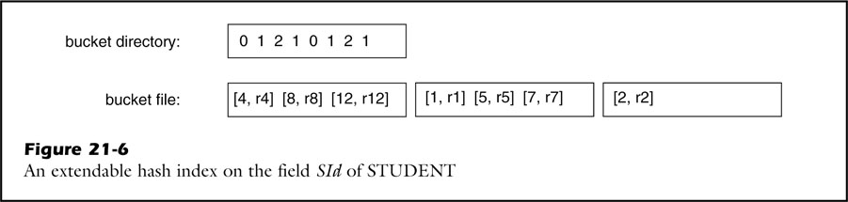
Extendable Hash Indexes
3 index records fit into a block
Only 8 buckets are used
The hash function h(x) = x mode 8
The STUDENT table contains 7 records
Having ID 1, 2, 4, 5, 7, 8 and 12

Slide 26
Extendable Hash Indexes
x: 0 1 2 3 4 5 6 7
3 index records fit into a block
Only 8 buckets are used
The hash function h(x) = x mode 8
The STUDENT table contains 7 records
Having ID 1, 2, 4, 5, 7, 8 and 12

Slide 27
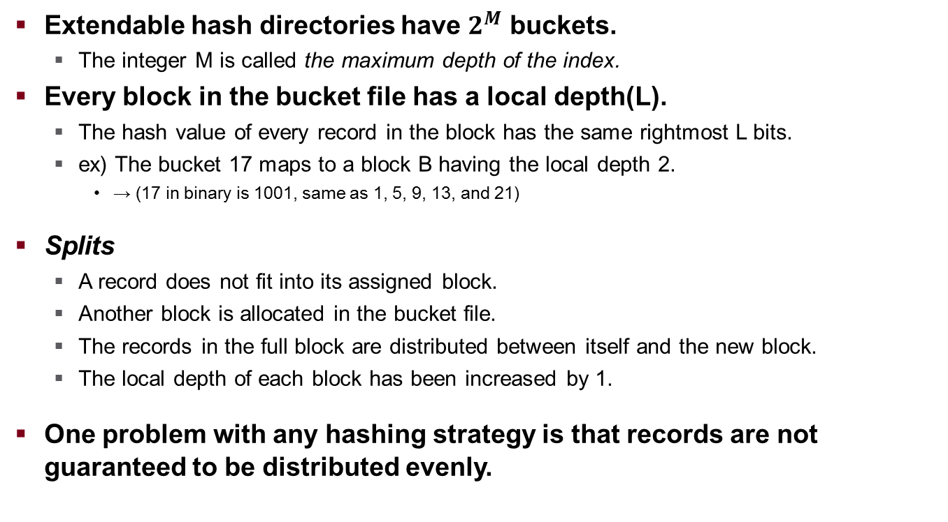
Sharing Index Blocks
Extendable hash directories have $2^{M}$ buckets.
The integer M is called the maximum depth of the index.
Every block in the bucket file has a local depth(L).
The hash value of every record in the block has the same rightmost L bits.
ex) The bucket 17 maps to a block B having the local depth 2.
→ (17 in binary is 1001, same as 1, 5, 9, 13, and 21)
Splits
A record does not fit into its assigned block.
Another block is allocated in the bucket file.
The records in the full block are distributed between itself and the new block.
The local depth of each block has been increased by 1.
One problem with any hashing strategy is that records are not guaranteed to be distributed evenly.

Slide 28
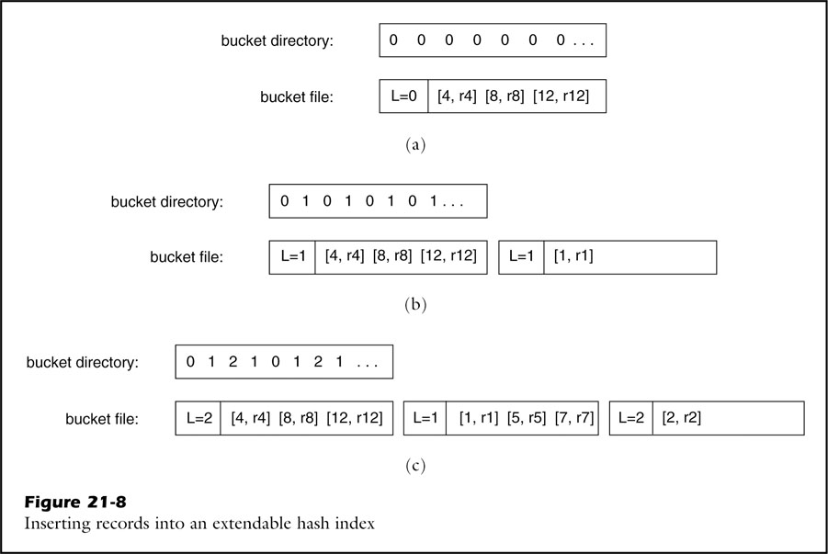
Sharing Index Blocks
Initially, the bucket file consists of one block, and all directory entries point to that block.

Slide 29
Sharing Index Blocks
- Insert index records
for students ‘1’
- The local depths are increased from 0 to 1

Slide 30
Sharing Index Blocks
The bucket directory has been changed to point to the new block.

Slide 31
Sharing Index Blocks
Insert index records
for students ‘5’, ‘7’, ‘2’.

Slide 32
Sharing Index Blocks
Block 0 splits again, because record 2 inserts to block 0.

Slide 33
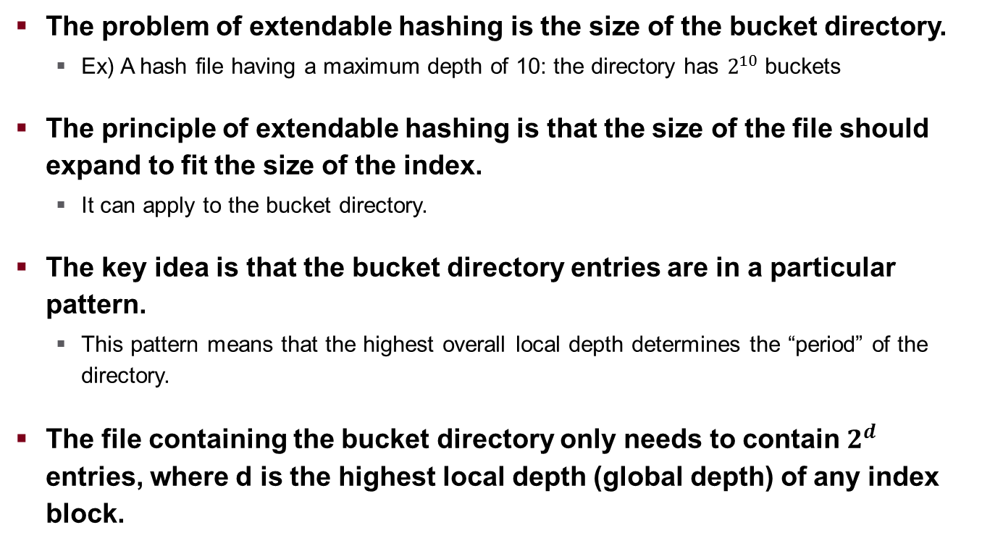
Compacting the Bucket Directory
The problem of extendable hashing is the size of the bucket directory.
Ex) A hash file having a maximum depth of 10: the directory has $2^{10}$ buckets
The principle of extendable hashing is that the size of the file should expand to fit the size of the index.
It can apply to the bucket directory.
The key idea is that the bucket directory entries are in a particular pattern.
This pattern means that the highest overall local depth determines the “period” of the directory.
The file containing the bucket directory only needs to contain $2^{d}$ entries, where d is the highest local depth (global depth) of any index block.

Slide 34
Contents
The Index Interface
Static Hash Indexes
Extendable Hash Indexes
B-Tree Indexes
How to Improve a Dictionary, The B-Tree Directory, A Directory Tree
Inserting Records, Duplicate Datavals
Implementing B-Tree Pages, Implementing B-Tree Indexes
Index-Aware Operator Implementations
Index Update Planning

Slide 35
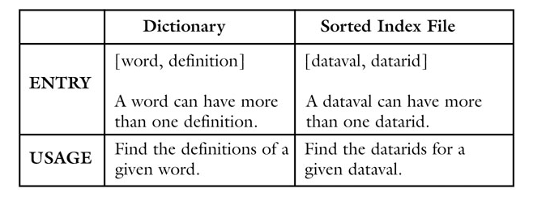
How to Improve a Dictionary
A sorted index sorts the records in the index file by their datavals.
An index file = A sequence of index records.
Each of Index records contains a dataval and a datarid.
A dictionary = A sequence of entries.
Each of entries contains a word and a definition.
The correspondence between a dictionary and sorted index file

Slide 36
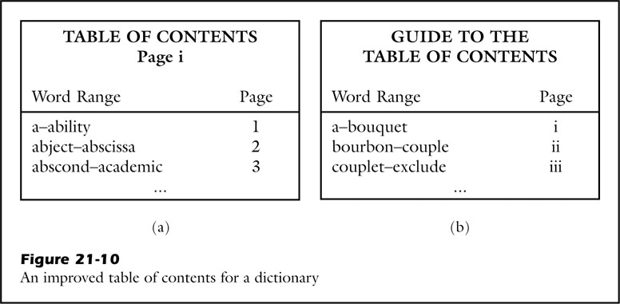
How to Improve a Dictionary
A 1000-page dictionary will have 1000 headers.
Header (in the Table of Contents) lists the first and last word on that page.
Searching through many headers is too much work.
Use the “ Guide to the Table of Contents”
List the header information for each page in the table of contents

Slide 37
How to Improve a Dictionary
The dictionary finds any word by looking at exactly 3 pages:
The guide page: which page in the table of contents to use
That table of contents page: which word-content page to use
That word-content page: find the my word
The table of contents is the level-0 directory, the guide is the level-1 directory, the guide to the guide is the level-2 directory, and so on.
Thus, our improved dictionary has the following structure:
There are numerous word-content pages, in sorted order.
Each level-0 directory page contains the header for several word-content pages.
Each level-(N+1) directory page contains the header for several level-N directory pages.
There is a single directory page at the highest level.

Slide 38
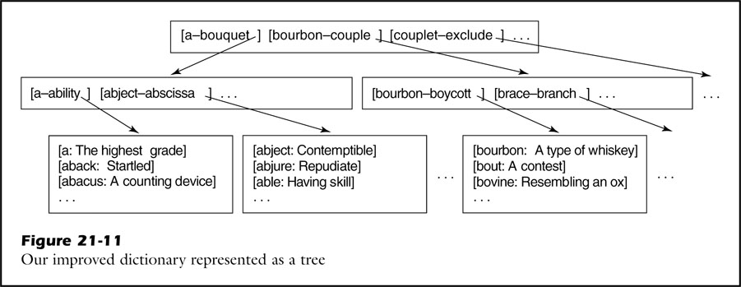
How to Improve a Dictionary
Level-1: root
Level-0
leaves

Slide 39
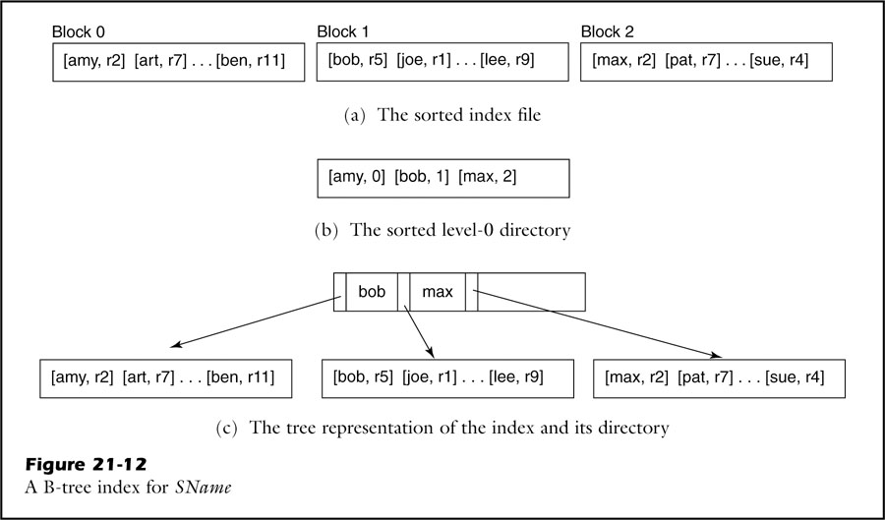
The B-Tree Directory
The concept of a tree-structured directory → The sorted indexes
The level-0 directory will have a record for each block of the file.
These directory records will be of the form [dataval, blocknum]
For example, A B-tree index for SName of STUDENT

Slide 40
The B-Tree Directory
The index file for a sorted index
on the field SName of STUDENT

Slide 41
The B-Tree Directory
The level-0 directory for this index file
This directory consists of 3 records, 1 for each index block.

Slide 42
The B-Tree Directory
Datavals range from “amy” up to “bob”(but not including)

Slide 43
The B-Tree Directory
Datavals range from “bob” up to “max”(but not including)

Slide 44
The B-Tree Directory
A directory and its index blocks are represented graphically as a tree, that is a B-tree example.

Slide 45
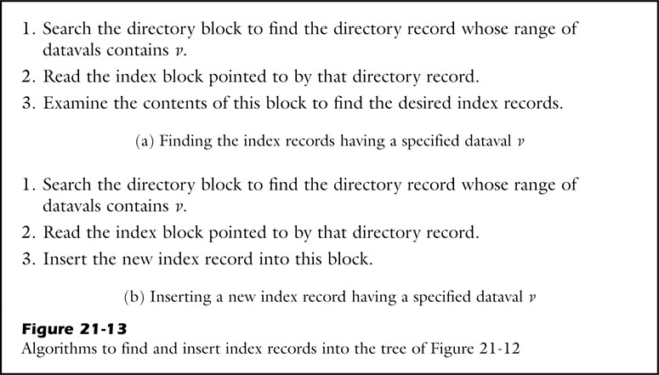
The B-Tree Directory

Slide 46
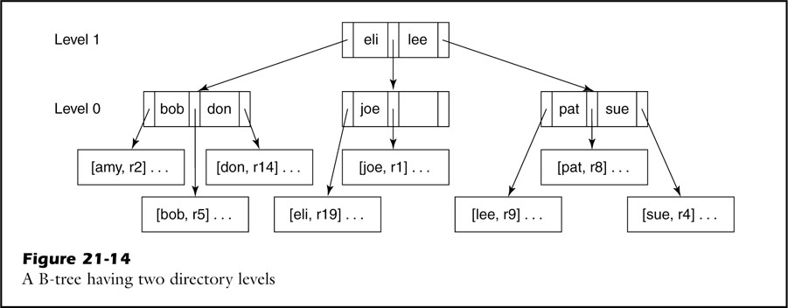
A Directory Tree
Level-1 contains the block
that points to the level-0 blocks.
Level-0 contains those blocks
hat point to the index blocks.

Slide 47
A Directory Tree
Search key = “jim”

Slide 48
A Directory Tree
“jim” lies between “eli” and “lee”

Slide 49
A Directory Tree
“jim” is less than “joe”

Slide 50
A Directory Tree
All index records for “jim” will be in this block!

Slide 51
A Directory Tree
The highest level will contain a single block.
This block is called the root of the B-tree.
A search of a B-tree requires accessing on directory block at each level, + one index block.
The search cost = the number of directory levels + 1

Slide 52
Inserting Records
What do we do if that block has no more room?
The solution is to split the block!
Splitting an index block entails the following activities:
Allocate a new block in the index file
Move the high-valued half of the index records into this new block
Create a directory record for the new block
Insert this new directory record into the same level-0 directory

Slide 53
Inserting Records
For example, Insert the new index record

Slide 54
Inserting Records
For example, Insert the new index record [hal, r55]
Insert the new index record “hal”

Slide 55
Inserting Records
For example, Insert the new index record [hal, r55]

Slide 56
Inserting Records
For example, Insert the new index record [hal, r55]
This block is full!

Slide 57
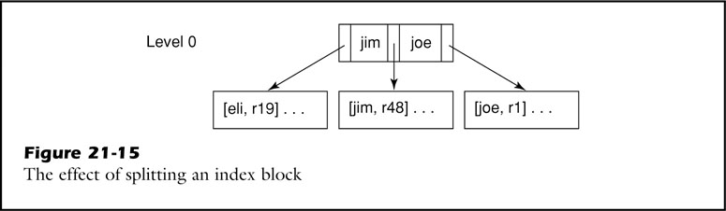
Inserting Records
For example, Insert the new index record [hal, r55]
Split block, moving the upper half of its records into the new block

Slide 58
Inserting Records
For example, Insert the new index record [hal, r55]
Split the index block
The first record of the new block is [jim, r48].

Slide 59
Inserting Records
For example, Insert the new index record

Slide 60
Inserting Records
For example, Insert the new index record [zoe, r56]
Insert the new index record “zoe”

Slide 61
Inserting Records
For example, Insert the new index record [zoe, r56]

Slide 62
Inserting Records
For example, Insert the new index record [zoe, r56]
This block is split.
The first record of the new block is “tom”.

Slide 63
Inserting Records
For example, Insert the new index record [zoe, r56]
Insert “tom”s record to this block
But, this is full!!!!

Slide 64
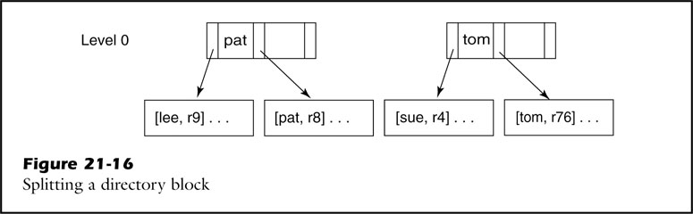
Inserting Records
For example, Insert the new index record [zoe, r56]
Split directory block and index block!

Slide 65
Inserting Records
For example, Insert the new index record [zoe, r56]
Split the directory block
If the root block splits, then a new root block is created, and the B-tree gains an additional level.
In example, the root became a new level-2 block.
Two directory records stay in the original block and move to the new block.

Slide 66
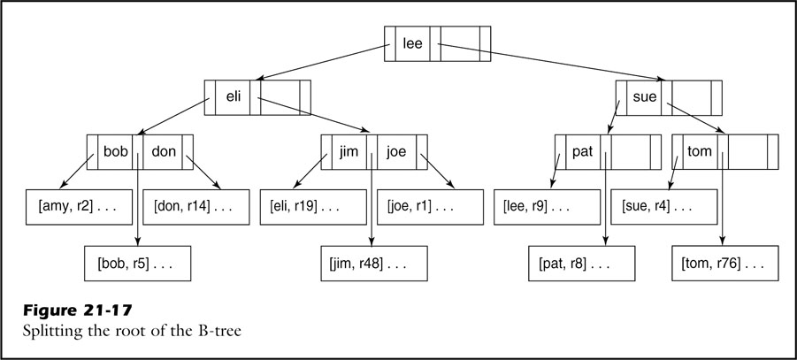
Duplicate Datavals
When you split a block, we must place all records having the same dataval in the same block.
For example, insert a record for “peg”

Slide 67
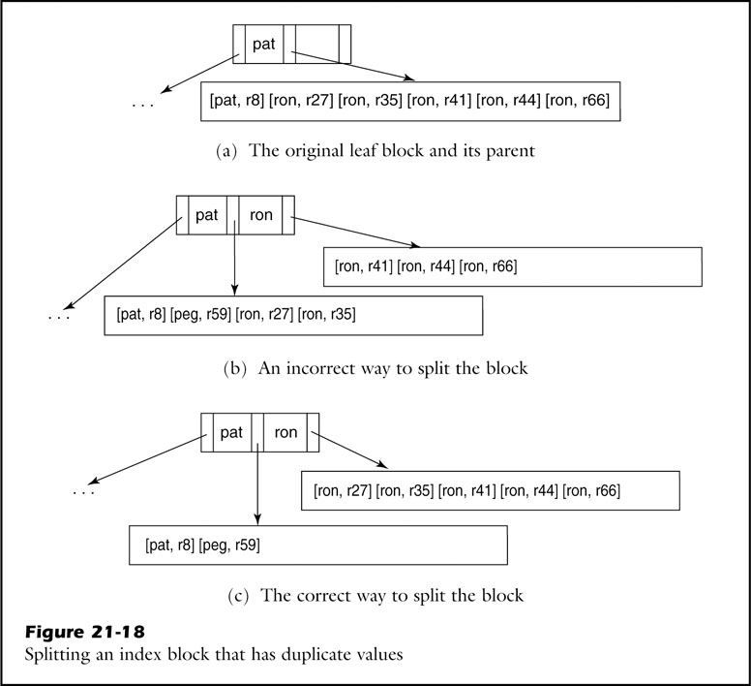
Duplicate Datavals
There are several records
for the dataval “ron”

Slide 68
Duplicate Datavals
Insert a record for “peg”

Slide 69
Duplicate Datavals
The result of splitting
the block evenly

Slide 70
Duplicate Datavals
Placing the five “ron”
records in the new block

Slide 71
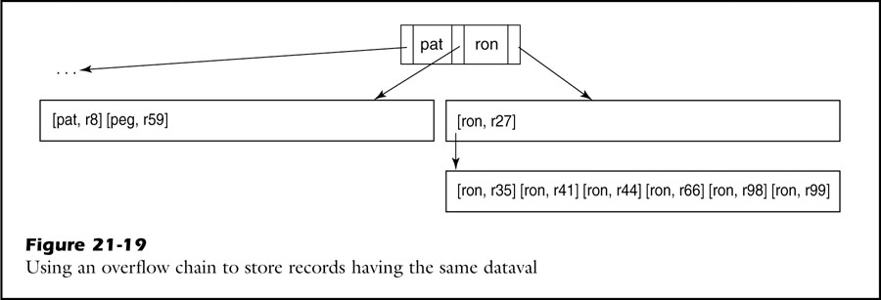
Duplicate Datavals
The only real problem occurs when all of the records in the index block have the same dataval.
Best approach is to use an overflow block.
An index block can contain a chain of overflow blocks.
Each overflow block will be completely filled.
Overflow block

Slide 72
Duplicate Datavals
If the block fills up again, there are two possibilities:
If there are at least two different datavals in the block, it splits.
If the block contains only one type records, another overflow block is created and chained to the existing one.
Position of the search key in blocks
Not the first key: examine the records in the blocks as before
The first key: we use the records in the overflow chain.

Slide 73
Implementing B-Tree Pages
The SimpleDB’s B-Tree package contains 4 principal classes:
BTreeDir, BTreeLeaf, BTreeIndex, BtreePage
BTreeDir, BTreeLeaf
Implement the directory and index blocks of a B-Tree
BTreeIndex
Implements the actual B-tree operations
Records in a B-Tree page have the following requirements:
The records need to be maintained in sorted order.
The records do not need to have a permanent ID.
A page needs to be able to split its records with another page.
Each page needs an integer to serve as a flag.

Slide 74
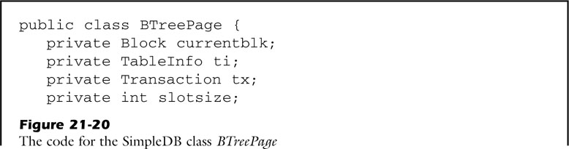
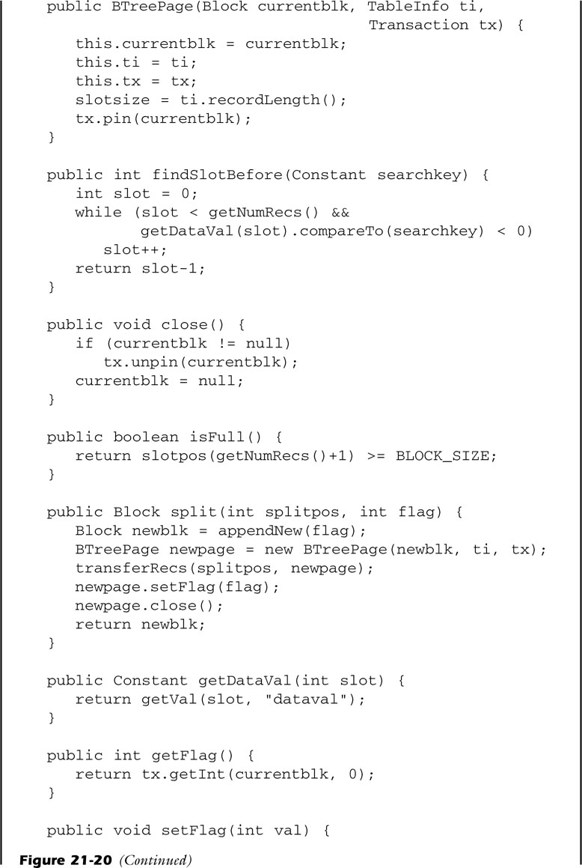
Implementing B-Tree Pages
Take a search key k as argument
Find the smallest slot x such that k≤dataval(k) → Returns the slot before that

Slide 75
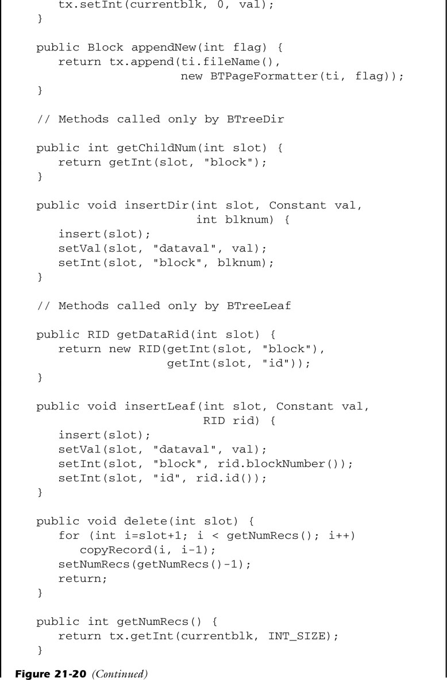
Implementing B-Tree Pages

Slide 76
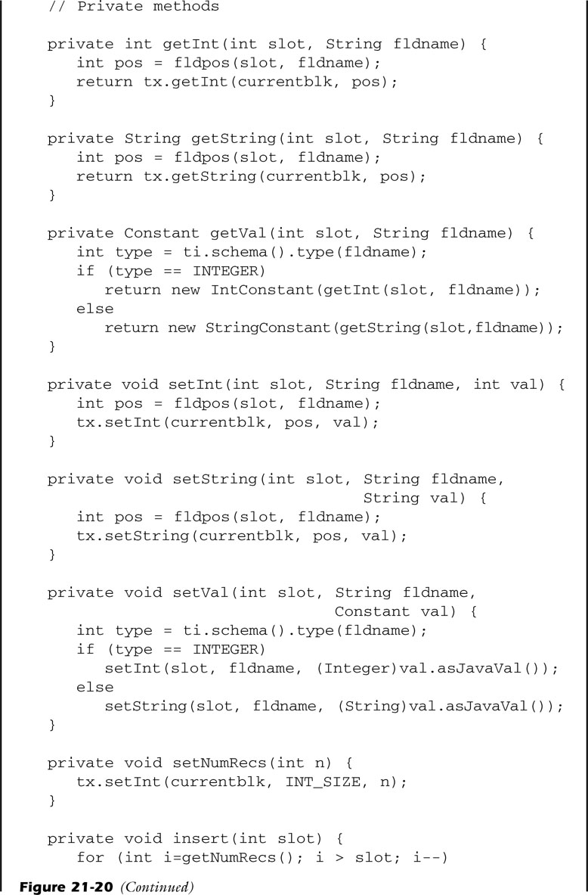
Implementing B-Tree Pages

Slide 77
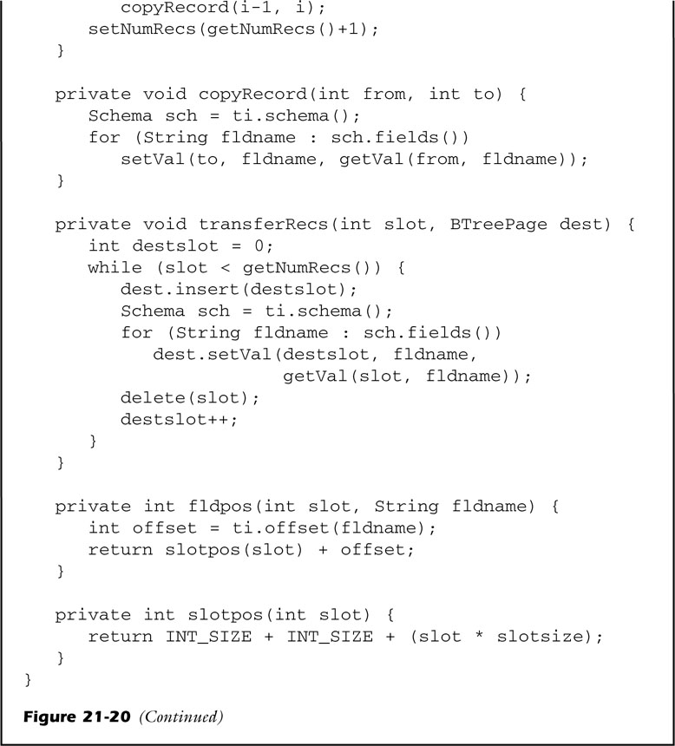
Implementing B-Tree Pages

Slide 78
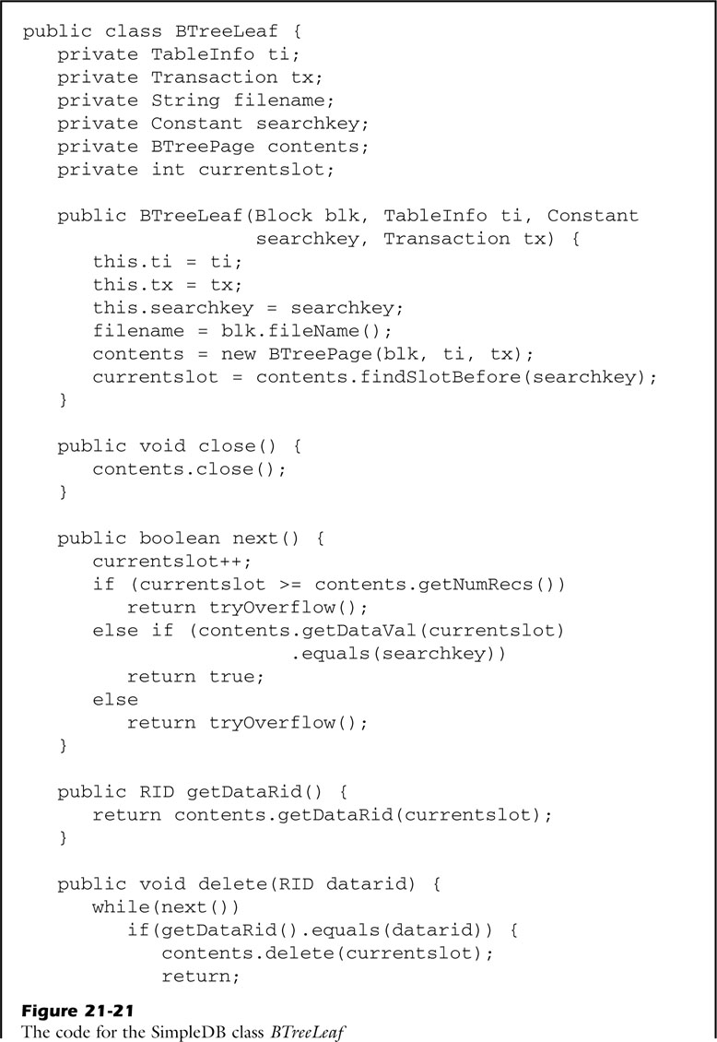
Implementing B-Tree Pages
Create a B-Tree page for the specific block
Call findSlotBefore to position itself

Slide 79
Implementing B-Tree Pages
Move to the next record
Return true or false depending on whether that record has the desired search key

Slide 80
Implementing B-Tree Pages
Calls ‘next’ until it encounters the index record having the specified rid

Slide 81
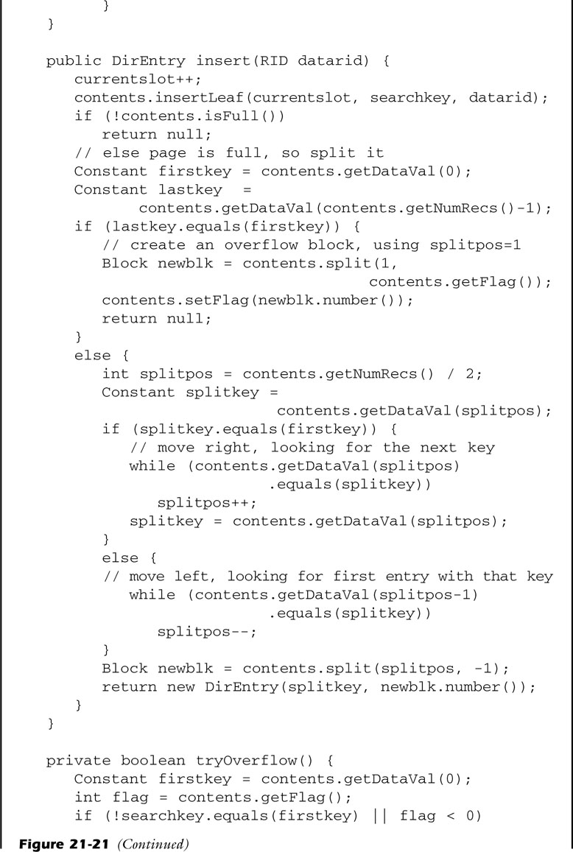
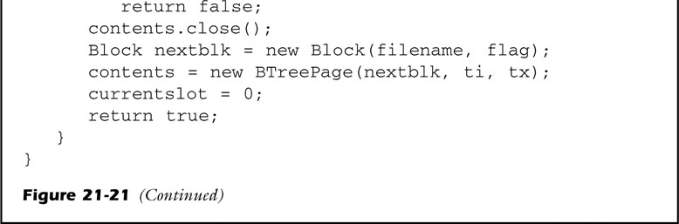
Implementing B-Tree Pages
It is positioned at the first record greater than or equal to that search key.

Slide 82
Implementing B-Tree Pages
Handles the possibility that the leaf block contains an overflow chain

Slide 83
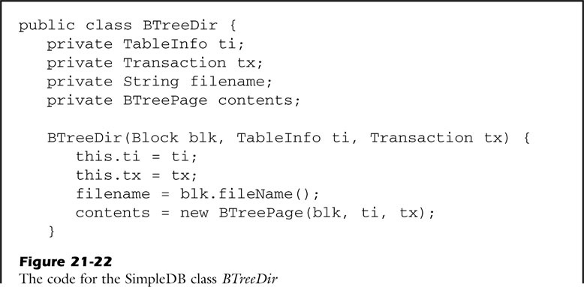
Implementing B-Tree Pages
Implement directory blocks

Slide 84
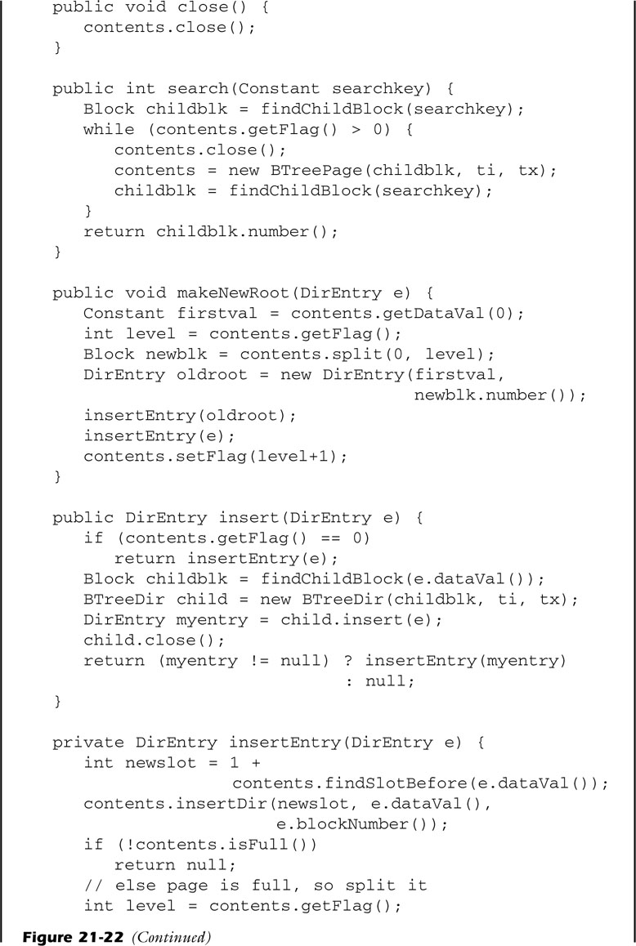
Implementing B-Tree Pages
Use a simple while-loop to move down the tree

Slide 85
Implementing B-Tree Pages
Use recursion to move down the tree

Slide 86
Implementing B-Tree Pages
Insert a new directory record into the page

Slide 87
Implementing B-Tree Pages
Be invoked when a call to insert on the root page returns a non-null value

Slide 88
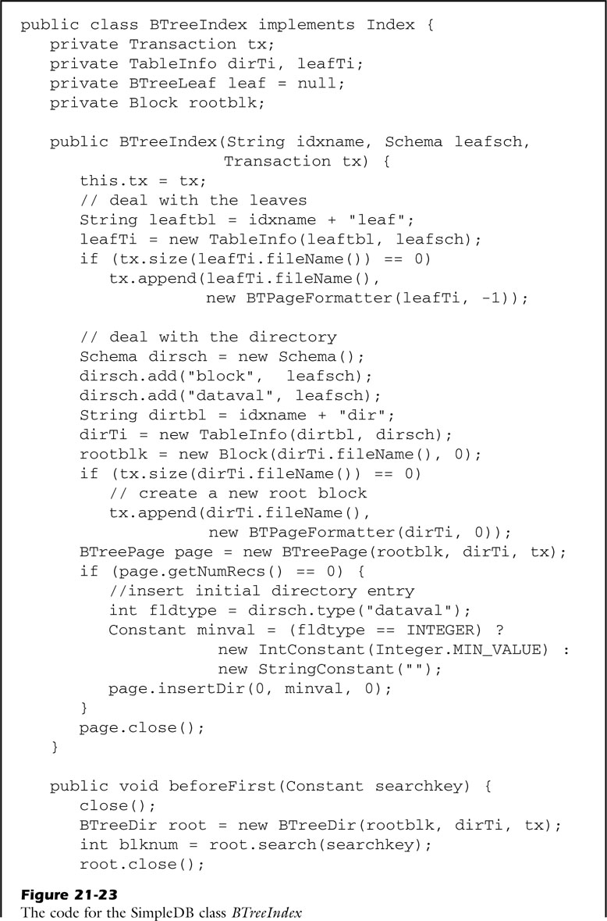
Implementing B-Tree Indexes
Implements the methods of the Index interface, coordinating the use of directory and leaf pages.

Slide 89
Implementing B-Tree Indexes
Keeps track of the current index record

Slide 90
Implementing B-Tree Indexes
Initializes the leaf object

Slide 91
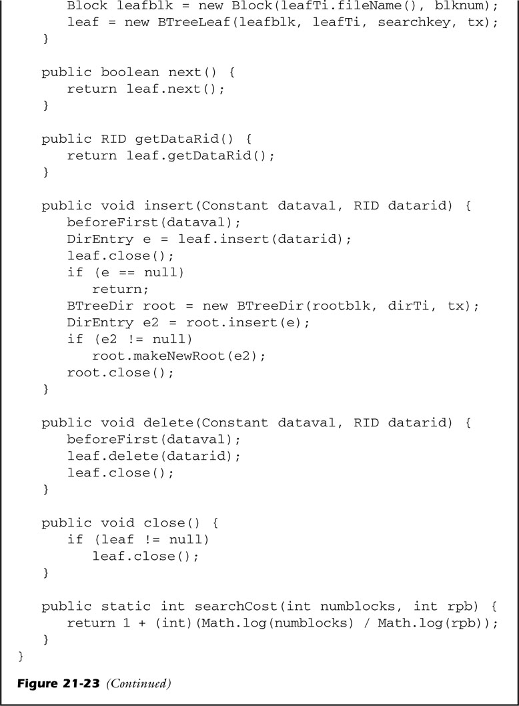
Implementing B-Tree Indexes
Locates the appropriate leaf page
Inserts the index record into it

Slide 92
Implementing B-Tree Indexes
Deletes the index record from the leaf

Slide 93
Contents
The Index Interface
Static Hash Indexes
Extendable Hash Indexes
B-Tree Indexes
Index-Aware Operator Implementations
An Indexed Implementation of Select, An Indexed Implementation of Join
Index Update Planning

Slide 94
Index-Aware Operator Implementations
Given an SQL query, the planner has 2 tasks to perform:
It must determine the appropriate query tree.
It must choose a plan for each operator in the tree.
Implementations for the select and join operators that use indexes

Slide 95
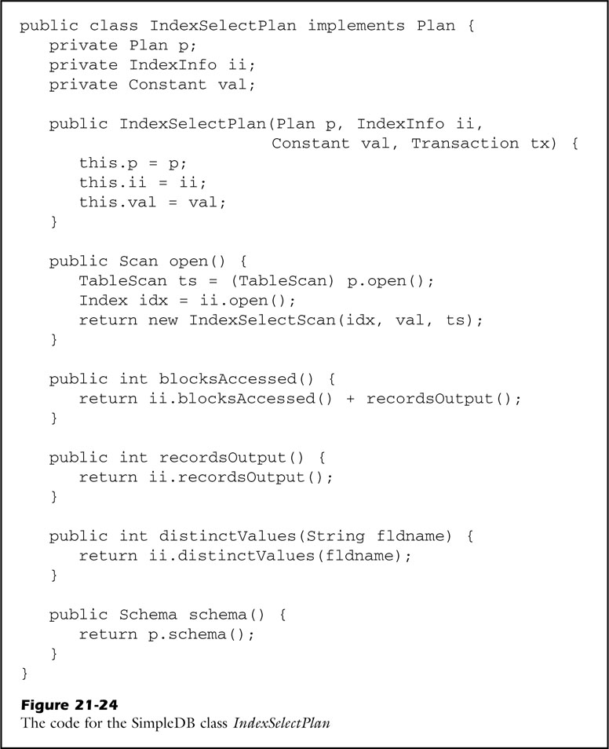
An Indexed Implementation of Select
Implements the select operator

Slide 96
An Indexed Implementation of Select
4 arguments:
The plan for the underlying table
The information about the applicable index
The selection constant
The current transaction

Slide 97
An Indexed Implementation of Select
Opens the index
Passes index to the IndexSelectScan

Slide 98
An Indexed Implementation of Select
Cost-estimation formulas

Slide 99
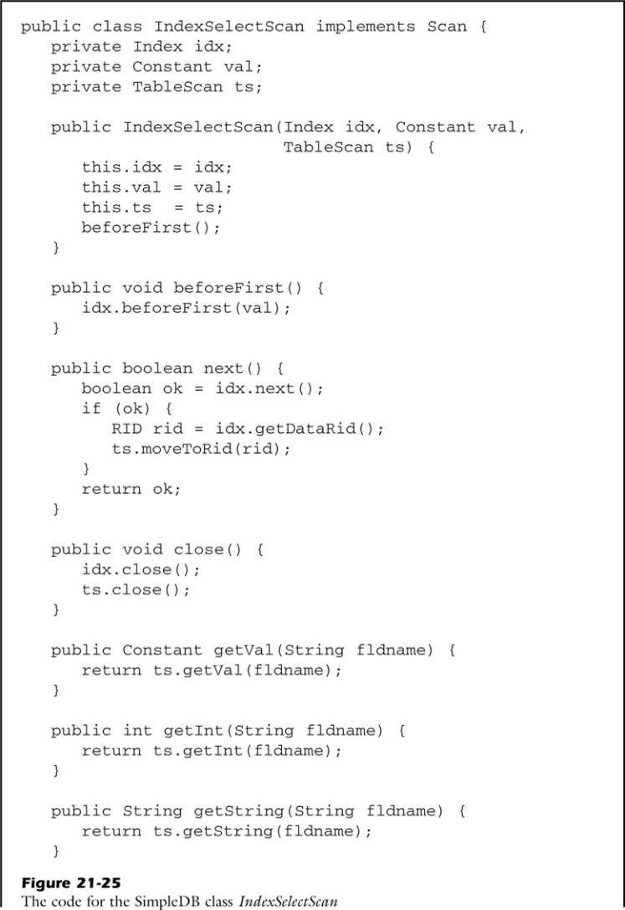
An Indexed Implementation of Select
idx: holds the current index record
ts: holds the current data record

Slide 100
An Indexed Implementation of Select
Moves to the next index record having the specified search constant.

Slide 101
An Indexed Implementation of Select
Pertain to the current data record

Slide 102
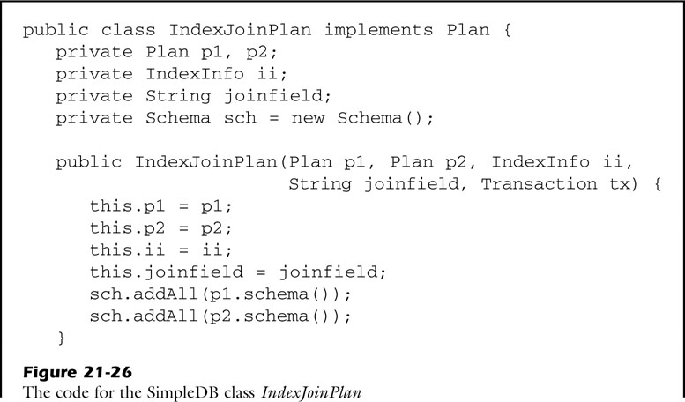
An Indexed Implementation of Join
The index join implementation holds the following conditions:
The underlying table T2 must be stored.
The predicate p must be of the form “A=B”.
Table T2 has an index on B.
Join(T1, T2, p)

Slide 103
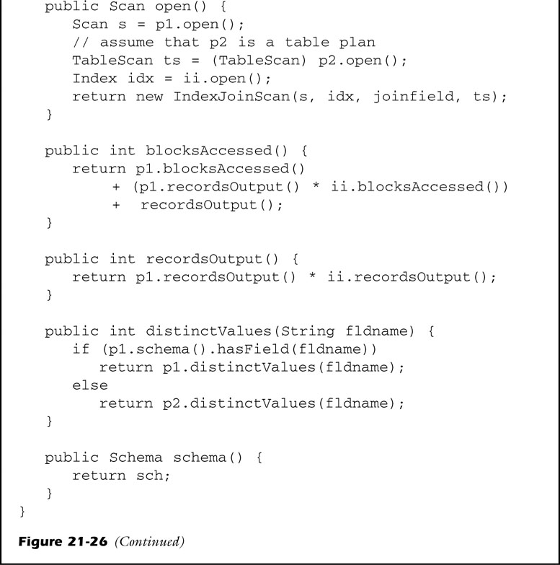
An Indexed Implementation of Join

Slide 104
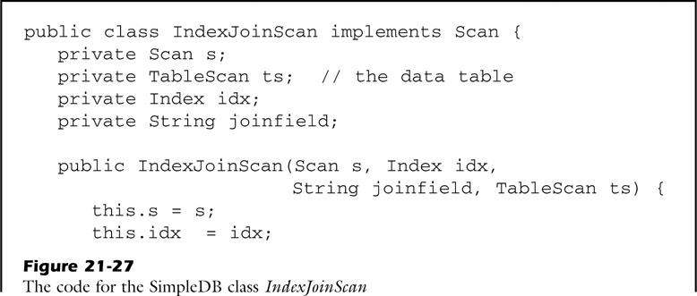
An Indexed Implementation of Join

Slide 105
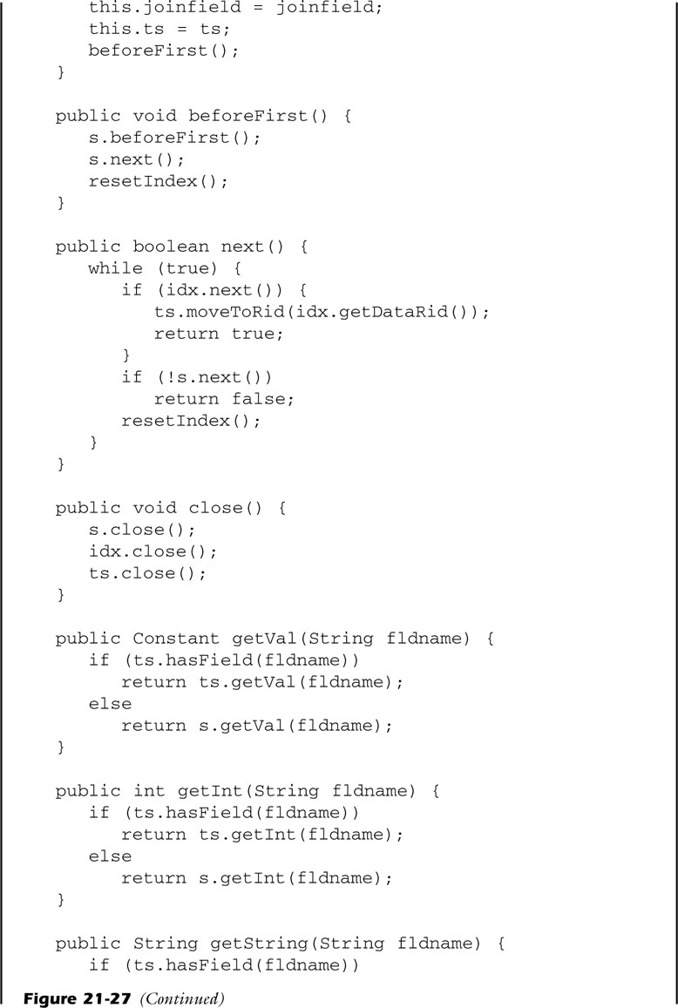
An Indexed Implementation of Join

Slide 106
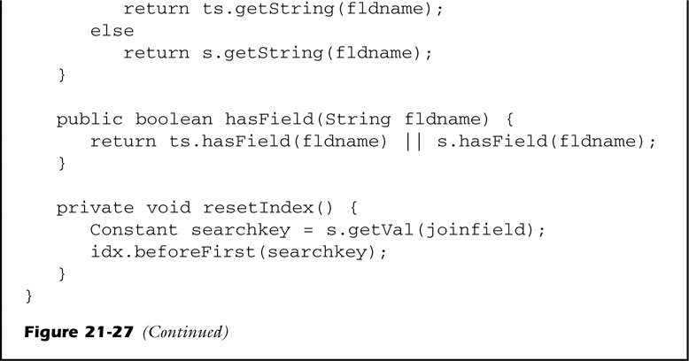
An Indexed Implementation of Join

Slide 107
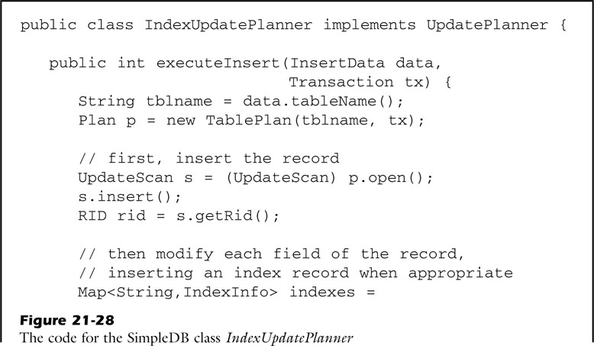
Index Update Planning
Query planner must ensure that there is a corresponding change to each of its index records.
Retrieves the index information of the mentioned table

Slide 108
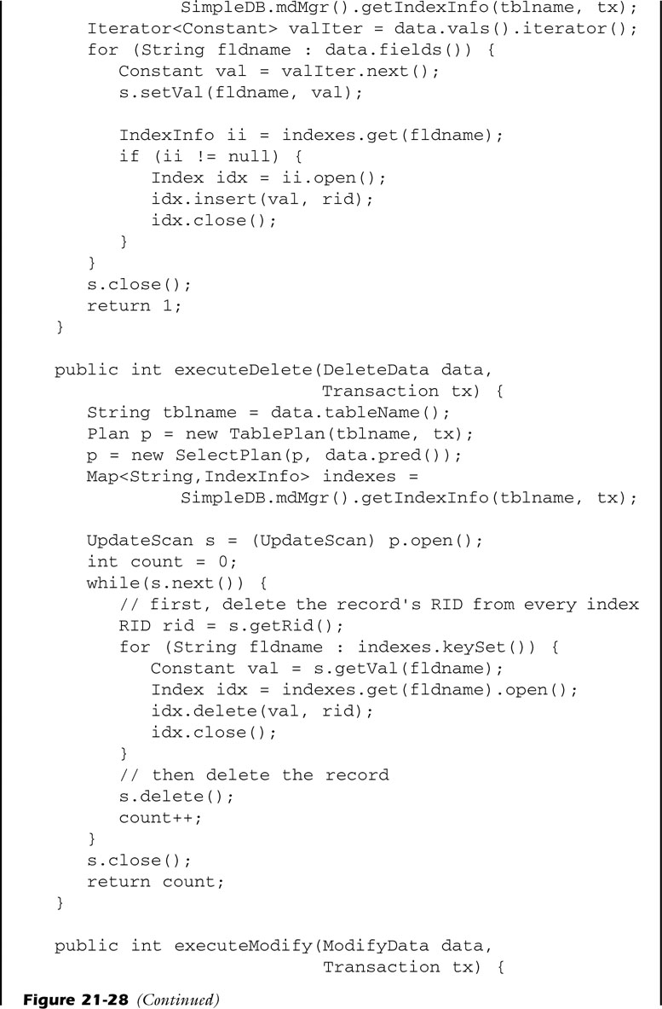
Index Update Planning
Constructs a scan of records to be deleted

Slide 109
Index Update Planning
Constructs the scan of records to be modified
It deletes the old index record and inserts a new one.

Slide 110
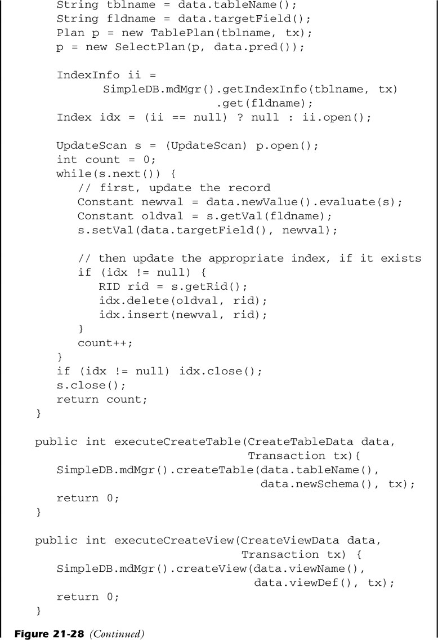
Index Update Planning

Slide 111
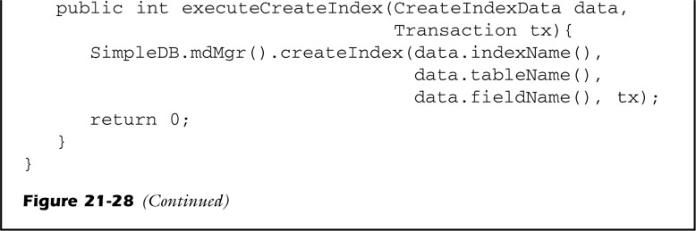
Index Update Planning
same as in the basic planner

Slide 112
Q n A

